Slide 1
Traffic Congestion
Earhart Elementary
September 2017

Slide 2
Stakeholders
Students
Faculty
Parents/Guardians
Afterschool Program Leaders
Paratransit Drivers
Alameda Police Department
Alameda Unified School District
Alameda Public Works Department / Road Design Engineers
Residents and users of Packet Landing Road and surrounding area

Slide 3
Information Sources
Principal Dean
PTA
Faculty
Parents/Guardians
Alameda Police Department
Alameda Public Works Department / Road Design Engineers
Residents and users of Packet Landing Road and surrounding area
Crossing Guards

Slide 4
Existing Conditions
~675 students getting picked up and dropped off at the same time
Many modes of transportation including vehicles, bikes, pedestrian, strollers, etc.
Handicap drop zone in parking lot
White zone in school parking lot
White zone on Packet Landing
One way in and one way out of Packet Landing
Two crossing guards at main intersection, paid for by City of Alameda Police Department
Signalized Intersection at Packet Landing and Robert Davey Jr.

Slide 5
Existing Conditions Map
2
CROSSING GUARDS
HANDICAP DROP
ENTRANCE / EXIT

Slide 6
Traffic Impacts
Congestion during drop-off and pick-up
School lot white zone and Packet Landing white zone being utilized for parents to sometimes park and walk child in or wait while child walks in
District vehicles parking in school white zone during peak times
Afterschool programs parking in Packet Landing white zone during peak times
Afterschool programs parking in kindergarten white zone during peak times
Parents parking in staff parking spaces

Slide 7
Traffic Solutions
Striping/Furnishings
Communication
Enforcement
Alternatives

Slide 8
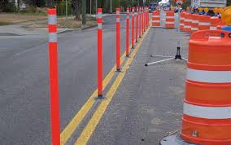
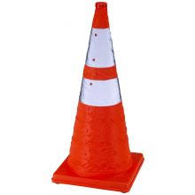
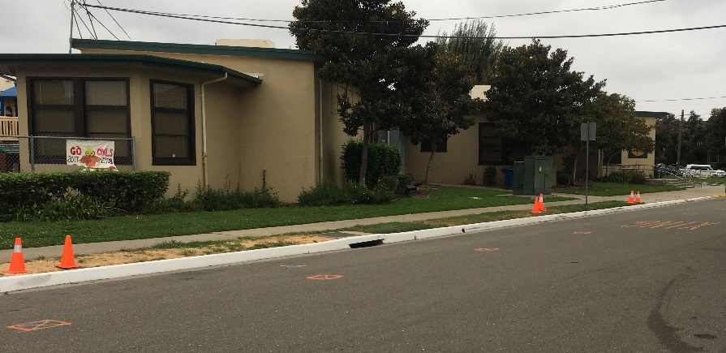
Traffic Solutions
Striping/Furnishings
Re-striping of School Lot per City Engineer
Stanchions in School Lot to define drop off lane and through traffic lane
Re-striping of Packet Landing to formalize parking spaces and organize parking - may result in overall loss of parking, but benefit is it would be more organized
Consideration of additional drop-off zone on Robert Davey Jr.

Slide 9
Striping/Furnishings
STANCHIONS

Slide 10
Traffic Solutions
Enforcement
Parents and/or Fifth Grade Ambassadors in School Lot and Packet Landing White Zones
Hiring of additional crossing guard to supervise School Lot rather than parent or student ambassadors - $15+ / hr x School Days x 2=$XX
Police Department Patrol – request directly of PD

Slide 11
Traffic Mitigation Measures
Communication
Re-signing of School Lot to impress “drop zone only” – no walk-in/wait
Right turn out of school driveway
Training messages sent out directly from teachers re how to treat the white zone
Parents NEVER parking in staff parking spaces, unless XX time of day
Formalize Communication of Parking Rules with Outside Entities:
District vehicles ONLY parking in school white zone at off-peak times
Afterschool programs ONLY parking on Packet Landing in standard parking areas and NEVER parking in kindergarten white zone
Others?

Slide 12
Traffic Mitigation Measures
Alternatives
Walking School Bus Program – Need to promote heavily
Bike
Walk
Roll
Carpool
Park off of Packet Landing and walk in via crossing guards

Slide 13
Traffic Solutions Options Map
2
CROSSING GUARDS
HANDICAP DROP
ENTRANCE / EXIT
POTENTIAL DROP ZONE
PARALELL PRKG STRIPING

Slide 14
Summary
Prepare signage plan for loading zones
Prepare communications plan/template for parents, district and outside entities
Promote Alternatives
Consider PTA funding of additional crossing guard inside school lot
Prepare request to City to re-consider Robert Davey Jr. Drop Zone
Prepare request to City to formalized parking space striping plan for Packet Landing
Perhaps a committee of interested parents is formed to focus on this issue and address these tasks?

